Slide 1
Conditional Formatting
Jon Carmo
Natasha Costa
Spencer Perruzzi

Slide 2
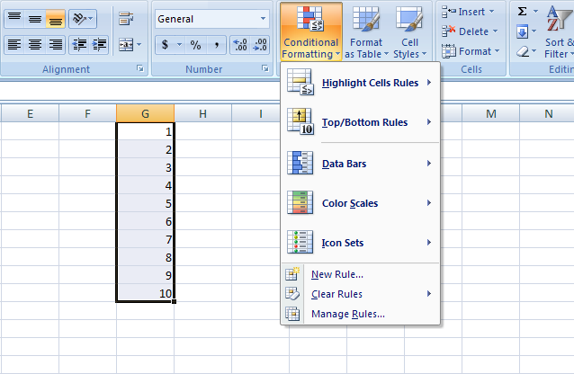
To get to conditional formatting, open the Home tab in your ribbon and click the Conditional Formatting icon.

Slide 3
Using Color Scales
Color scales can visually demonstrate the value of a figure in comparison to the entire range of data.
← For example, a set of data can be compared by shading the larger number red and the smaller number green.

Slide 4
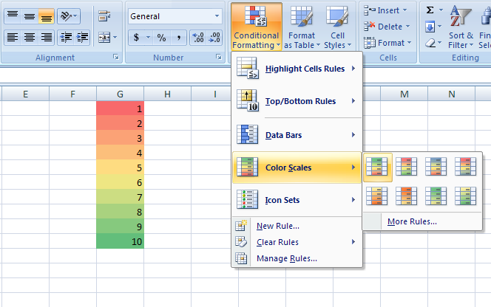
To utilize the Color Scales tool, highlight your data and scroll over the Color Scales option under the Conditional Formatting menu. Then, choose the scale of your preference.

Slide 5
Using Data Bars
Data bars are used to visually
compare individual figures
to one another.
Essentially, a longer bar
means a higher value.

Slide 6
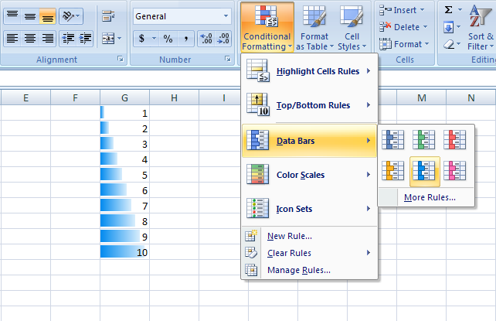
To create data bars, highlight your data, then scroll over the Data Bars option under Conditional Formatting. Then, choose whichever style and color you prefer.

Slide 7
Using Icon Sets
Icon sets create visuals to help identify trends and patterns in a set of data.
← For example, you could use arrow icons to show where a number would be if the set
were in numerical order.

Slide 8
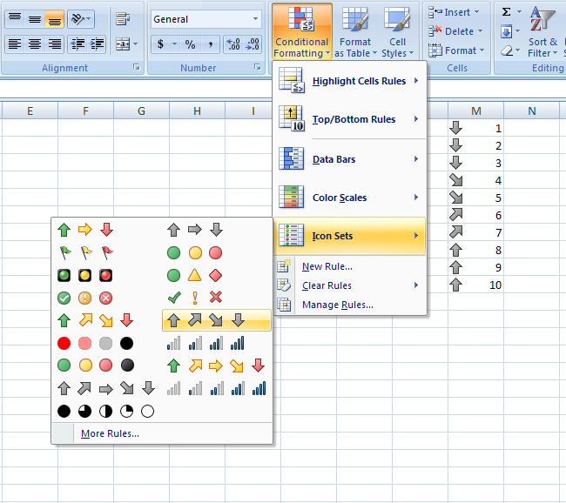
To utilize icon sets, highlight your data, then scroll over the Icon Sets option under conditional formatting. Then, select whichever icon set you prefer.

